Slide 1
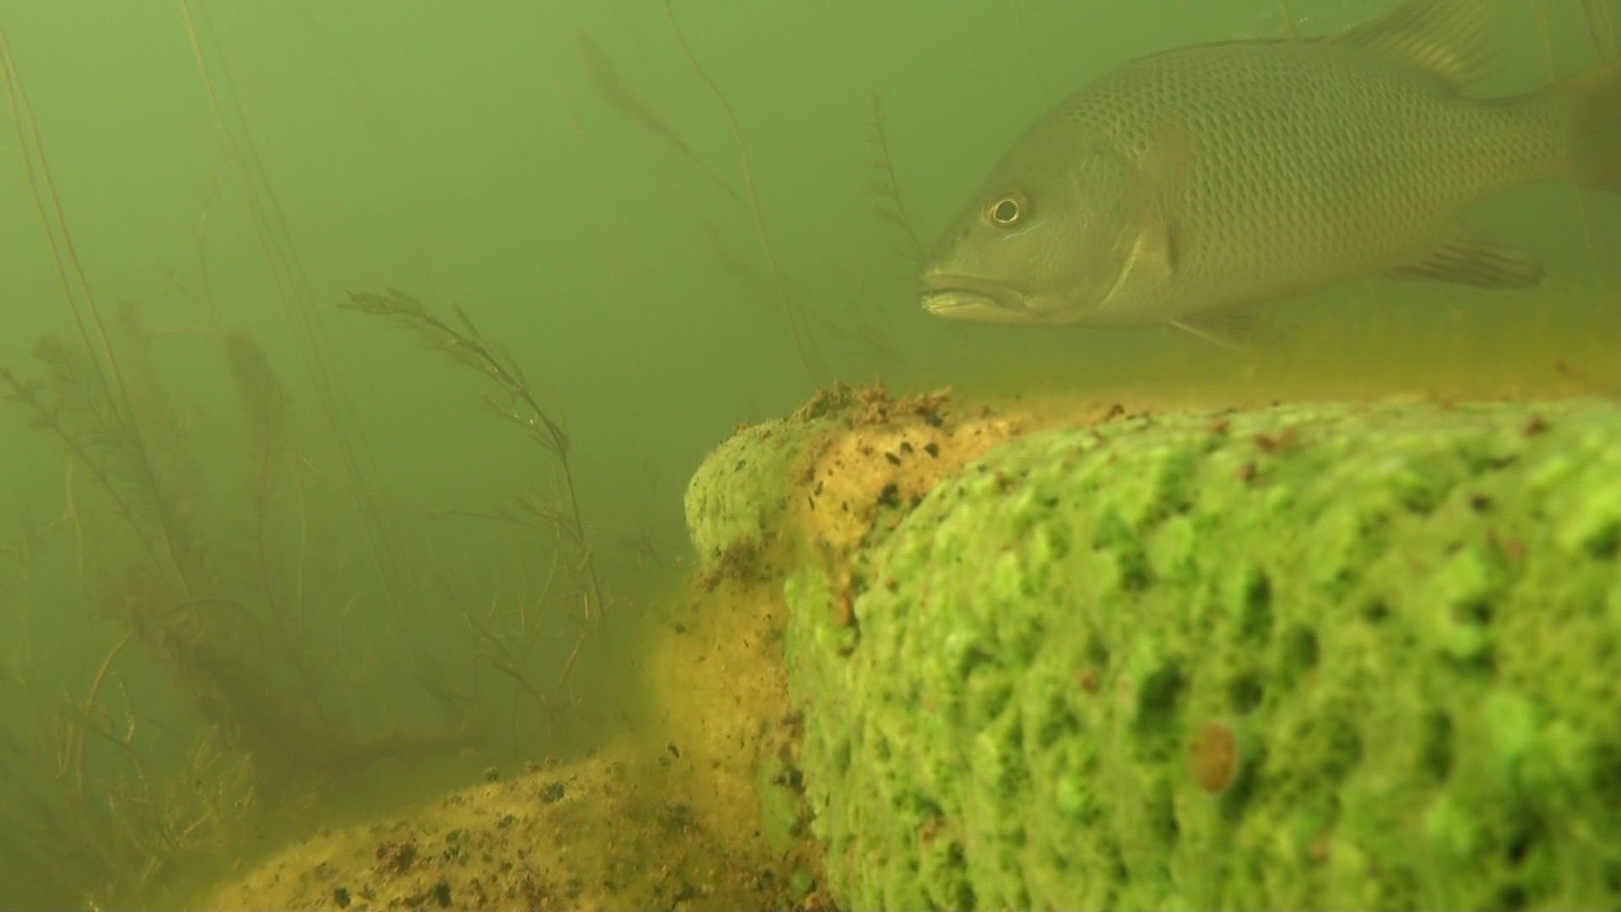
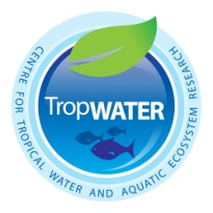
Underwater video for surveying fauna
Description, environmental monitoring & uses
Benefits & constraints
Key research & researchers
Priorities for technique development
Sample videos
Ebb
brendan.ebner@csiro.au
04 5792 5768

Slide 2
Underwater video for surveying fauna
Description, Environmental monitoring and uses
Focus: still images, motion (habitat coverage/condition, species identification, behaviour and processes)
Fixed or mobile applications (Diver, tethered, remote control, automated, animal)
Above and below water
Rapid deployments or surveillance (power supply, processing)
Monitoring a species (threatened species, other native species, pest species)
Monitoring an assemblage
Monitoring a process or interaction (e.g. pest species and native assemblage) (e.g. fish passage at a dam)
Bait v. no bait
Monitoring v communications

Slide 3
Underwater video for surveying fauna
BENEFITS
Affordability of cameras
Portability and flexibility in placement
For studying large bodied aquatic species
Minimal observer effect
Threatened species research
Overcomes human fatigue in the field
Safety (e.g. crocodiles)
Permanent record
Public communication: People love watching highlights
CONSTRAINTS
Visibility
Small field of view
Processing time, cost & expertise
Identification of small animals

Slide 4
Underwater video for surveying fauna
KEY RESEARCHERS
Lars Bredjer (Murdoch University)
Sean Doody (Southeastern Louisiana University)
Euan Harvey (Curtin Uni)
John Keesing (CSIRO)
Jon Marshall (DSITIA Qld)
Brendan Ebner, James Donaldson, Nathan Waltham, Jason Schaffer, Michael Bradley, Marcus Sheaves, Ronnie Baker (TropWATER, JCU)
David Morgan (Murdoch University)
Cameron Fletcher (CSIRO)

Slide 5
KEY RESEARCH PAPERS
Boom, B.J., He, J., Palazzo, S., Huang, P.X., Beyan, C., Chou, H.M., Lin, F.P., Spampinato, C. and Fisher, R.B. (2014). A research tool for long-term and continuous analysis of fish assemblage in coral-reefs using underwater camera footage. Ecological Informatics 23, 83-97.
Ebner, B., Clear, R., Godschalx, S., & Beitzel, M. (2009). In-stream behaviour of threatened fishes and their food organisms based on remote video monitoring.
Aquatic Ecology 43, 569–576.
Ebner, B. C. & Morgan D. L. (2013). Using remote underwater video to estimate freshwater fish species richness. Journal of Fish Biology 82, 1592–1612.
Ebner, B. C., Starrs, D. Morgan, D. L., Fulton, C. J. Donaldson, J. A., Doody, S., Cousins, S., Kennard, M., Butler, G., Tonkin, Z., Beatty, S., Broadhurst, B., Clear, R. & Fletcher, C. (2014). Emergence of underwater video for field based study of freshwater fish and crustacean ecology in Australia. Journal of the Royal Society of Western Australia 97, 287–296.
Harvey, E. S., Cappo, M., Butler, J. J., Hall, N., & Kendrick, G. A. (2007). Bait attraction affects the performance of remote underwater video stations in assessment of demersal fish community structure. Marine Ecology Progress Series 350, 245-254.
Holmes, J. A., Cronkite, G. M., Enzenhofer, H. J., & Mulligan, T. J. (2006). Accuracy and precision of fish-count data from a “dual-frequency identification sonar” (DIDSON) imaging system. ICES Journal of Marine Science: Journal du Conseil 63, 543-555.
Mallet, D., & Pelletier, D. (2014). Underwater video techniques for observing coastal marine biodiversity: a review of sixty years of publications (1952–2012).
Fisheries Research 154, 44-62.
Misund, O. A. (1997). Underwater acoustics in marine fisheries and fisheries research. Reviews in Fish Biology and Fisheries, 7, 1-34.
Murphy, H. M., & Jenkins, G. P. (2010). Observational methods used in marine spatial monitoring of fishes and associated habitats: a review.
Marine and Freshwater Research 61, 236-252.

Slide 6
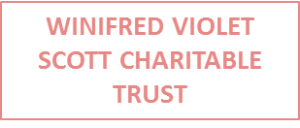
Broadhurst, B., Thiem, J. and Ebner, B. 2006. Video monitoring in upland streams. In An ecological approach to re-establishing Australian freshwater cod populations: an application to trout cod in the Murrumbidgee catchment. (Ebner, B., Thiem, J., Lintermans, M. and Gilligan, D., eds), pp.95 – 104. Final report to the Fisheries Research and Development Corporation (Project No. 2003/034). Canberra: Parks, Conservation and Lands
Cousins, S. (2011). Composition and structure of fish assemblages in the deep benthic zone of lowland rivers in the Wet Tropics of Far North Queensland, using Remote Underwater Video. Australian Rivers Institute, Griffith University, Brisbane. Unpublished Honours Thesis (57 pp.).
Cousins, S., Kennard, M. J. & Ebner, B. C. (In prep.). Depth related composition and structuring of tropical riverine fish assemblages revealed by baited video.
Marine and Freshwater Research
Donaldson, J. D., Drews Jr, P., Bradley, M. J., Morgan, D., Baker, R. & Ebner B. C. (In prep.). Countering low visibility in video survey of an estuarine fish assemblage. Journal of Fish Biology
Ebner, B. C., Donaldson, J. D., Allen, G., & Keith, P. (In prep.). Testing an underwater video network and first record of Sicyopterus cynocephalus in Australia. Cybium
Ebner, B., Clear, R., Godschalx, S., & Beitzel, M. (2009). In-stream behaviour of threatened fishes and their food organisms based on remote videomonitoring.
Aquatic Ecology 43, 569–576.
Ebner, B. C., Fletcher, C., Donaldson, J. D., Fulton, C., & Seymour (In prep). Moray feeding modes and motifs. J. Animal Ecology
Ebner, B. C., Fulton, C. J., Donaldson, J. A., Cousins, S., Mecynecke, J-O., Schaffer J. & Kennard, M. J. (2015). Filming and snorkelling as mobile visual techniques to survey tropical rainforest stream fauna. Marine and Freshwater Research 66, 120–126.
Ebner, B. C. & Morgan D. L. (2013). Using remote underwater video to estimate freshwater fish species richness. Journal of Fish Biology 82, 1592–1612.
Ebner, B. C., Starrs, D. Morgan, D. L., Fulton, C. J. Donaldson, J. A., Doody, S., Cousins, S., Kennard, M., Butler, G., Tonkin, Z., Beatty, S., Broadhurst, B., Clear, R. & Fletcher, C. (2014). Emergence of underwater video for field based study of freshwater fish and crustacean ecology in Australia. Journal of the Royal Society of Western Australia 97, 287–296.
Fulton, C. J, Starrs, D., Ruibal, M. P. & Ebner, B. C. (2012). Counting crayfish: active searching and baited cameras trump conventional hoop netting in detecting Euastacus armatus. Endangered Species Research 19, 39–45.
Lintermans, M., Broadhurst, B. T., Thiem, J. D., Ebner, B. C., Wright, D., Clear, R. C., & Norris, R. H. (2010). Constructed homes for threatened fishes in the Cotter River catchment: Phase 2 final report. Report to ACTEW Corporation. Institute for Applied Ecology, University of Canberra, Canberra.
Starrs, D., Ebner, B. C., & Fulton, C. J. (2015). Ceasefire: minimal aggression among Murray River crayfish feeding on patches of allochthonous material. Australian Journal of Zoology 63, 115–121.
Thiem, J. D., Ebner, B. C., & Clear, R. C. (2010). Validating variation in radio-signal strength as an index of aquatic fauna activity. Australian Journal of Zoology 58, 50–55.

